Slide 1
Essentials of Geometry
Geometry
Chapter 1
Notes:
Geometry 1

Slide 2
This Slideshow was developed to accompany the textbook
  Larson Geometry
  By Larson, R., Boswell, L., Kanold, T. D., & Stiff, L.
  2011 Holt McDougal
Some examples and diagrams are taken from the textbook.
Slides created by
Richard Wright, Andrews Academy
rwright@andrews.edu

Slide 3
1.1 Identify Points, Lines, and Planes
What is it?
What is it like?
Undefined Term
Dot
No Dimension
Point A •
Point A
A
How is it named?

Slide 4
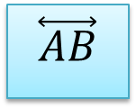
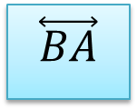
1.1 Identify Points, Lines, and Planes
What is it?
What is it like?
Undefined Term
No Thickness
Goes forever
m
A B
Line • •
Straight
1 Dimension
m
$$\overset{⃡}{AB}$$
$$\overset{⃡}{BA}$$
Through any two points there is exactly one line.
How is it named?

Slide 5

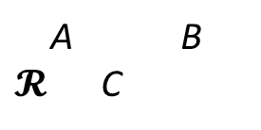
1.1 Identify Points, Lines, and Planes
What is it?
What is it like?
Undefined Term
No Thickness
Plane • •
•
Goes forever in both directions
A B
$𝓡$ C
2 Dimensions
Plane $𝓡$
Plane ABC
Through any three noncollinear points, there is exactly one plane.
How is it named?

Slide 6
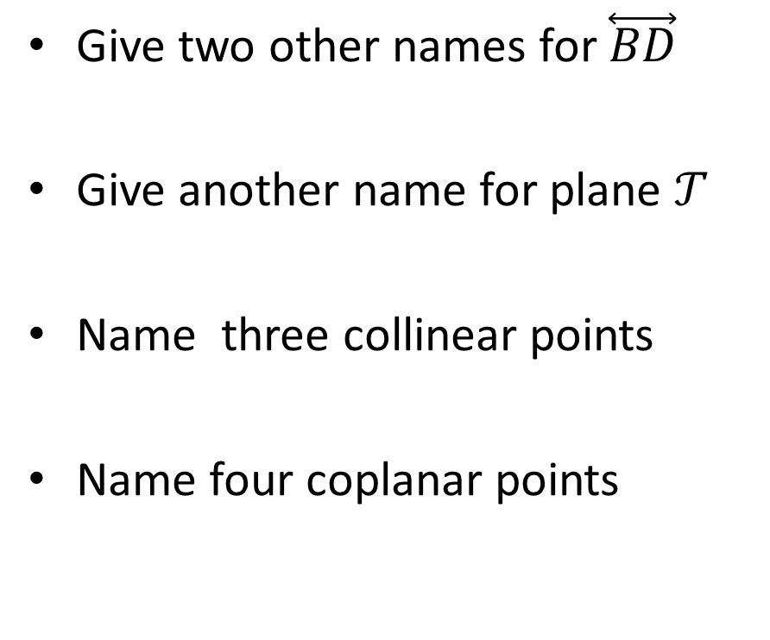

1.1 Identify Points, Lines, and Planes
Give two other names for $\overset{⃡}{BD}$
Give another name for plane $𝒯$
Name three collinear points
Name four coplanar points
ℓ
$$𝒯$$
A
D
B
m
E
C
Notes:
DB, m
Plane ABE
A, B, C
A, B, C, E

Slide 7
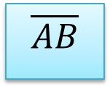
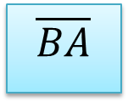
1.1 Identify Points, Lines, and Planes
What is it?
What is it like?
Part of a Line
Part of a line between two endpoints
Segment • •
A B
Does NOT go on forever
Named by endpoints
$$\overline{AB}$$
$$\overline{BA}$$
How is it named?

Slide 8
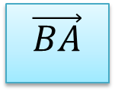
1.1 Identify Points, Lines, and Planes
What is it?
What is it like?
Part of a Line
Part of a line starting at one endpoint and continuing forever
Ray • •
A B
Goes forever in one direction only
Named by endpoint followed by one other point
$$\vec{BA}$$
If two rays have the same endpoint and go in opposite directions, they are called opposite rays.
How is it named?
A
C
B

Slide 9
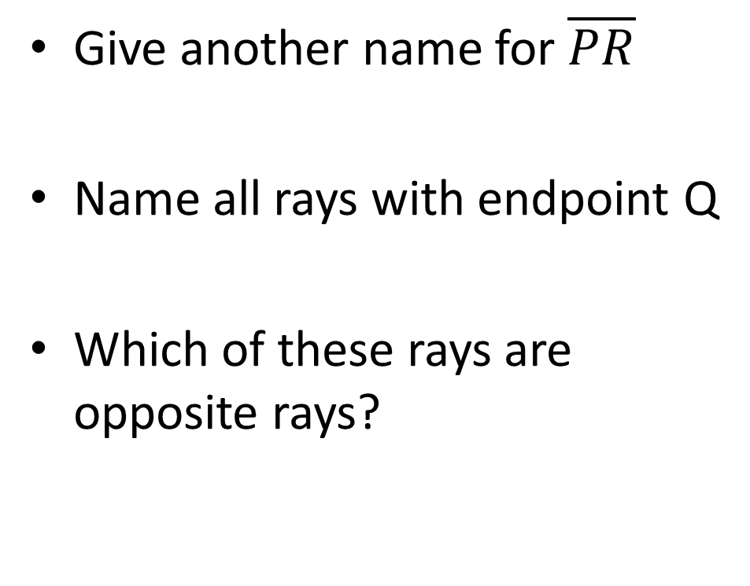
1.1 Identify Points, Lines, and Planes
Give another name for $\overline{PR}$
Name all rays with endpoint Q
Which of these rays are opposite rays?
P
T
Q
R
S
The intersection of two lines is a point.
Notes:
RP
QP, QR, QT, QS
QT and QS; QP and QR

Slide 10
1.1 Identify Points, Lines, and Planes
The intersection of two planes is a line.

Slide 11
1.1 Identify Points, Lines, and Planes
Sketch a plane and two intersecting lines that intersect the plane at separate points.
Sketch a plane and two intersecting lines that do not intersect the plane.
Sketch a plane and two intersecting lines that lie in the plane.

Slide 12
1.1 Identify Points, Lines, and Planes
5 #1, 4-38 even, 44-58 even = 27 total

Slide 13
1.1 Grading and Quiz
1.1 Answers
1.1 Homework Quiz

Slide 14
1.2 Use Segment and Congruence
Postulate – Rule that is accepted without proof
Theorem – Rule that is proven
-2
-1
0
1
2
3
4
Ruler Postulate
A
B
Any line can be turned into a number line

Slide 15
1.2 Use Segment and Congruence
What is it?
What is it like?
Length measurement
Difference of the coordinates of the points
Distance
AB = | x₂ – x₁ |
AB
BA
-2
-1
0
1
2
3
4
How is it named?
A
B
Find AB
Notes:
AB = 3 – (-1) = 4

Slide 16
1.2 Use Segment and Congruence
What is it?
What is it like?
Point Placement
On the segment with the other points as the endpoints
Between
Does not have to be the midpoint
A B C
A B C
What are examples?

Slide 17
1.2 Use Segment and Congruence
Segment Addition Postulate
AB
BC
If B is between A and C, then AB + BC = AC
A
B
C
AC
If AB + BC = AC, then B is between A and C
42
Find CD
C
D
17
E
Notes:
CD + DE = CE
CD + 17 = 42
CD = 25

Slide 18
1.2 Use Segment and Congruence
Graph X(-2, -5) and Y(-2, 3).
Find XY.
Notes:
XY = 3 – (-5) = 8

Slide 19
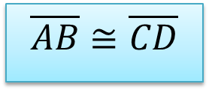
1.2 Use Segment and Congruence
What is it?
What is it like?
Comparing shapes
Segments with same length
Congruent Segment
≅ means segments are exactly alike
= means lengths are equal
A
B
$$\overline{AB}≅\overline{CD}$$
C
D
What are examples?

Slide 20
1.2 Use Segment and Congruence
12 #4-36 even, 37-45 all = 26 total

Slide 21
1.2 Grading and Quiz
1.2 Answers
1.2 Homework Quiz

Slide 22
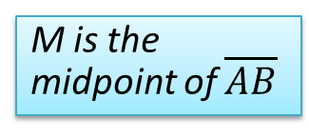
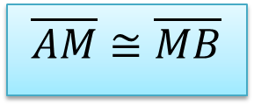
1.3 Use Midpoint and Distance Formulas
What is it?
What is it like?
Part of a Segment
Very middle of the segment
Point that divides the segment into two congruent segments.
Midpoint
A
M
B
M is the midpoint of $\overline{AB}$
$$\overline{AM}≅\overline{MB}$$
AM = MB
What are some examples?
Segment Bisector is something that intersects a segment at its midpoint.

Slide 23
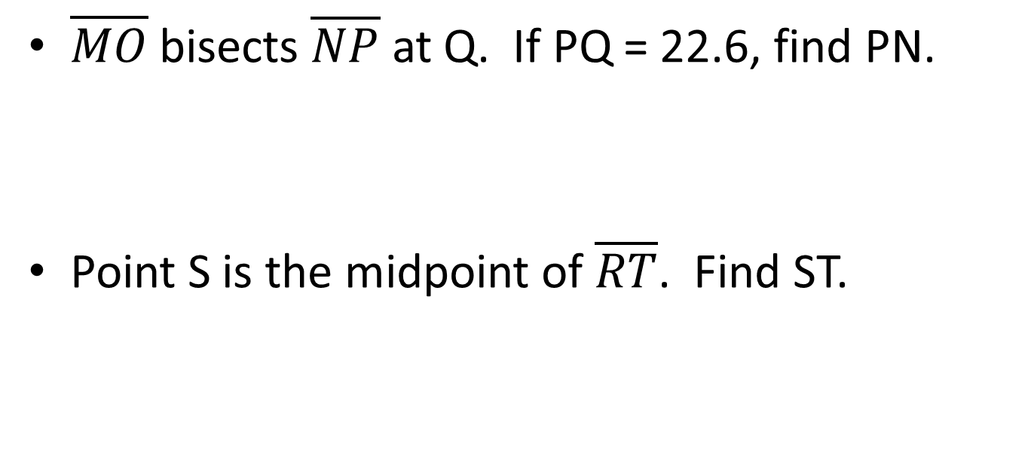
1.3 Use Midpoint and Distance Formulas
$\overline{MO}$ bisects $\overline{NP}$ at Q. If PQ = 22.6, find PN.
Point S is the midpoint of $\overline{RT}$. Find ST.
N
M
Q
O
P
R
S
T
5x - 2
3x + 8
Notes:
PQ = ½ PN
22.6 = ½ PN
PN = 45.2
5x-2 = 3x+8
2x-2 = 8
2x = 10
x = 5
ST = 3(5) + 8 = 23

Slide 24
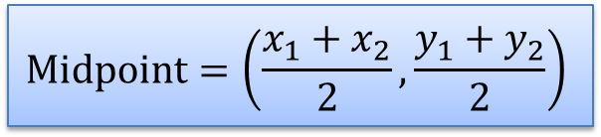
1.3 Use Midpoint and Distance Formulas
Midpoint Formula
$$\text{Midpoint}=\left(\frac{x_{1}+x_{2}}{2},\frac{y_{1}+y_{2}}{2}\right)$$
Find the midpoint of G(7, -2) and H(-5, -6)
Notes:
((7+-5)/2, (-2+-6)/2) = (1, -4)

Slide 25

1.3 Use Midpoint and Distance Formulas
The midpoint of $\overline{AB}$ is M(5, 8). One endpoint is A(2, -3). Find the coordinates of endpoint B.
Notes:
(5, 8) = ((x+2)/2, (y+-3)/2)
x-coords: 5 = (x+2)/2 → 10 = x+2 → x = 8
y-coords: 8 = (y-3)/2 → 16 = y-3 → y = 19
(8, 19)

Slide 26
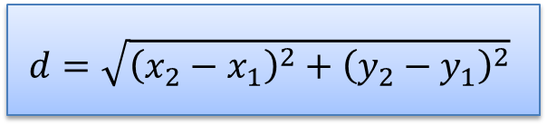
1.3 Use Midpoint and Distance Formulas
Distance Formula
$$d=\sqrt{{\left(x_{2}−x_{1}\right)}^{2}+{\left(y_{2}−y_{1}\right)}^{2}}$$
What is PQ if P(2, 5) and Q(-4, 8)?
19 #2, 4, 6, 10-20 even, 24, 26, 28, 32, 36, 38, 42, 44, 48, 54-64 all = 29 total
Extra Credit 22#2, 8
Notes:
PQ = √((-4 – 2)² + (8-5)²)
PQ = √((-6)² + (3)²)
PQ = √(36 + 9)
PQ = √45 = 3√5 ≈ 6.71

Slide 27
1.3 Grading and Quiz
1.3 Answers
1.3 Homework Quiz

Slide 28
1.4 Measure and Classify Angles
What is it?
What is it like?
Shape
Two rays with common endpoint (vertex)
Angle
Formed when two lines cross
∠BAC
∠CAB
∠A
B
How is it named?
sides
A
C
vertex

Slide 29
1.4 Measure and Classify Angles
Protractor Postulate
A protractor can be used to measure angles
What is it?
What is it like?
Angle measurement
Difference coordinates of each ray on a protractor
Measure
m∠A = |x₂–x₁|
m∠A
m∠BAC
How is it named?

Slide 30
1.4 Measure and Classify Angles
Classifying Angles
  Acute
    Less than 90°
  Right
    90°
  Obtuse
    More than 90°
  Straight
    180°
It’s such a cute angle!

Slide 31
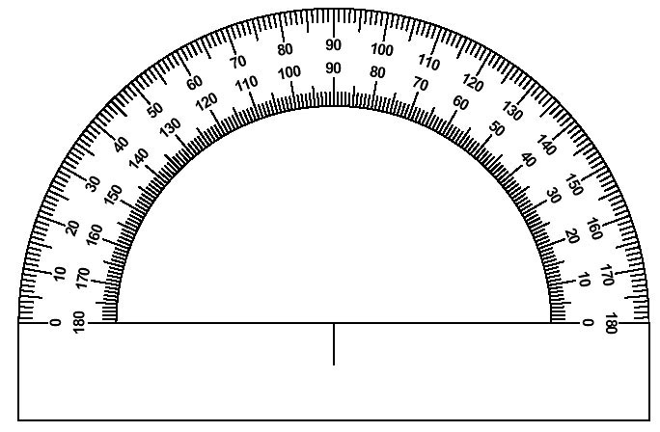
1.4 Measure and Classify Angles
Find the measure of each angle and classify.
  ∠DEC
  ∠DEA
  ∠CEB
  ∠DEB
B
C
A
E
D
Notes:
∠DEC = 90 right
∠DEA = 180 straight
∠CEB = 25 acute
∠DEB = 115 obtuse

Slide 32
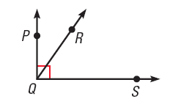
1.4 Measure and Classify Angles
Name all the angles in the diagram.
Which angle is a right angle?
Notes:
∠PQR , ∠PQS, ∠RQS ; ∠PQS is a right angle .

Slide 33
1.4 Measure and Classify Angles
Angle Addition Postulate
If P is in the interior of ∠RST, then
m∠RST = m∠RSP + m∠PST
R
P
If m∠RST = 72°, find m∠RSP and m∠PST
2x – 9
S
3x + 6
T
Notes:
2x-9 + 3x+6 = 72
5x-3=72
5x = 75
x = 15
m∠RSP = 2(15) – 9 = 21
m∠PST = 3(15) + 6 = 51

Slide 34
1.4 Measure and Classify Angles
What is it?
What is it like?
Comparing shapes
Angles with same measure
Congruent Angles
≅ means angles are exactly alike
= means measures are equal
∠ABC ≅ ∠DEF
What are examples?

Slide 35
1.4 Measure and Classify Angles
Identify all pairs of congruent angles in the diagram.
In the diagram, m∠PQR = 130, m∠QRS = 84, and m∠TSR = 121 . Find the other angle measures in the diagram.
Notes:
∠T ≅ ∠S, ∠P ≅ ∠R
m∠PTS = 121, m∠QPT = 84

Slide 36
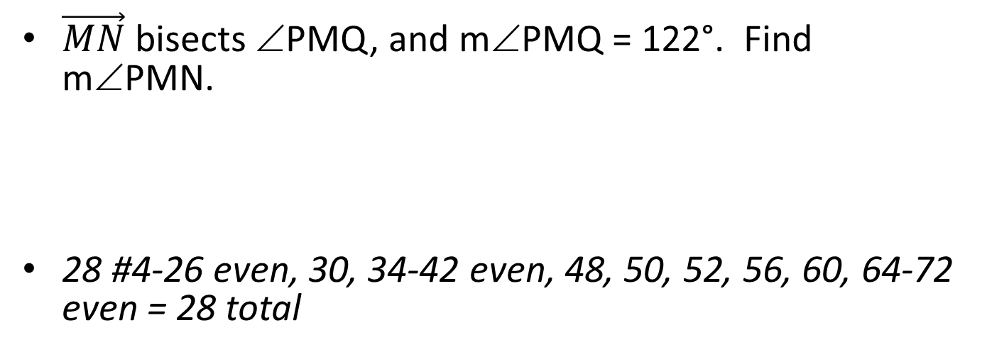
1.4 Measure and Classify Angles
Angle Bisector is a ray that divides an angle into two angles that are congruent.
$\vec{MN}$ bisects ∠PMQ, and m∠PMQ = 122°. Find m∠PMN.
28 #4-26 even, 30, 34-42 even, 48, 50, 52, 56, 60, 64-72 even = 28 total
N
Q
P
M

Slide 37
1.4 Grading and Quiz
1.4 Answers
1.4 Homework Quiz

Slide 38
1.5 Describe Angle Pair Relationships
What is it?
What is it like?
Angles Pairs
Angles that share a ray and vertex
Adjacent Angles
Are next to each other
Are not inside each other
What are examples?

Slide 39
1.5 Describe Angle Pair Relationships
Complementary Angles
Two angles whose sum is 90°
Supplementary Angles
Two angles whose sum is 180°
Complementary and Supplementary Angles do not have to be adjacent
Notes:
Both the pairs are supplementary

Slide 40
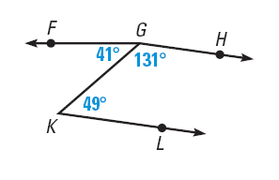
1.5 Describe Angle Pair Relationships
In the figure, name a pair of
  complementary
  angles,
  supplementary angles,
  adjacent angles.
Are ∠KGH and ∠LKG adjacent angles?
Are ∠ FGK and ∠FGH adjacent angles? Explain.
Notes:
Complementary: ∠FGK and ∠GKL
Supplementary: ∠HGK and ∠GKL
Adjacent: ∠FGK and HGK
No, they do not have a common vertex
No, they are inside of each other

Slide 41
1.5 Describe Angle Pair Relationships
Given that ∠1 is a complement of ∠2 and m∠2 = 8º, find m∠1.
Given that ∠3 is a supplement of ∠4 and
m∠3 = 117º, find m∠4.
Notes:
8 + x = 90 → x = 82
117 + y = 180 = 63

Slide 42
1.5 Describe Angle Pair Relationships
∠LMN and ∠PQR are complementary angles. Find the measures of the angles if
m∠LMN = (4x – 2)º and m∠PQR = (9x + 1)º.
Notes:
(4x – 2) + (9x + 1) = 90 → 13x – 1 = 90 → 13x = 91 → x = 7
m∠LMN = 4(7) – 2 = 26
m∠PQR = 9(7) + 1 = 64

Slide 43
1.5 Describe Angle Pair Relationships
What is it?
What is it like?
Angles Pairs
Angles that make a line
Linear Pair
Linear Pair
Adjacent angles
What are examples?

Slide 44
1.5 Describe Angle Pair Relationships
What is it?
What is it like?
Angles Pairs
Angles formed when 2 line cross
Vertical Angles
Are opposite sides of the intersection
Are not necessarily above each other
What are examples?
Vertical Angles are congruent.

Slide 45
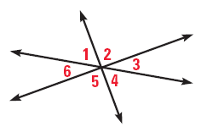
1.5 Describe Angle Pair Relationships
Do any of the numbered angles in the diagram below form a linear pair?
Which angles are vertical angles?
Notes:
No, no 2 of them form straight lines
∠1 and ∠4, ∠2 and ∠5, ∠3 and ∠6

Slide 46
1.5 Describe Angle Pair Relationships
Two angles form a linear pair. The measure of one angle is 3 times the measure of the other. Find the measure of each angle.
Notes:
x + 3x = 180 → 4x = 180 → x = 45 → angles are 45 and 135

Slide 47
1.5 Describe Angle Pair Relationships
Things you can assume in diagrams.
  Points are coplanar
  Intersections
  Lines are straight
  Betweenness
Things you cannot assume in diagrams
  Congruence unless stated
  Right angles unless stated

Slide 48
1.5 Describe Angle Pair Relationships
38 #4-28 even, 32-44 even, 54, 58, 60, 62 = 24 total
Extra Credit 41 #2, 6

Slide 49
1.5 Grading and Quiz
1.5 Answers
1.5 Homework Quiz

Slide 50
1.6 Classify Polygons
What happens when you leave the door of the birdcage open?
What is it?
What is it like?
Shape
Sides are straight lines
Polygon
Sides only intersect at ends
Closed shape
No curves
What are examples?
Notes:
You get a Polly gone

Slide 51
1.6 Classify Polygons
Convex
All angles poke out of shape.
A line containing a side does NOT go through the middle of the shape.
Concave
Not convex. (There’s a “cave”.)

Slide 52
1.6 Classify Polygons
Equilateral
All sides are the same length
Equiangular
All angles are the same measure

Slide 53
1.6 Classify Polygons
Regular Polygon
Equilateral and Equiangular

Slide 54
1.6 Classify Polygons
Number of
Type of
sides
Polygon
3
4
3
Triangle
4
Quadrilateral
6
5
Pentagon
6
Hexagon
7
Heptagon
5
10
8
Octagon
9
Nonagon
8
10
Decagon
12
Dodecagon
13
13
-
gon
7
12
n
n
-
gon

Slide 55
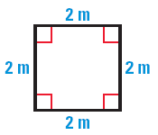
1.6 Classify Polygons
Sketch an example of a convex heptagon.
Sketch an example of a concave heptagon.
Classify the polygon shown.
Notes:
Regular quadrilateral

Slide 56
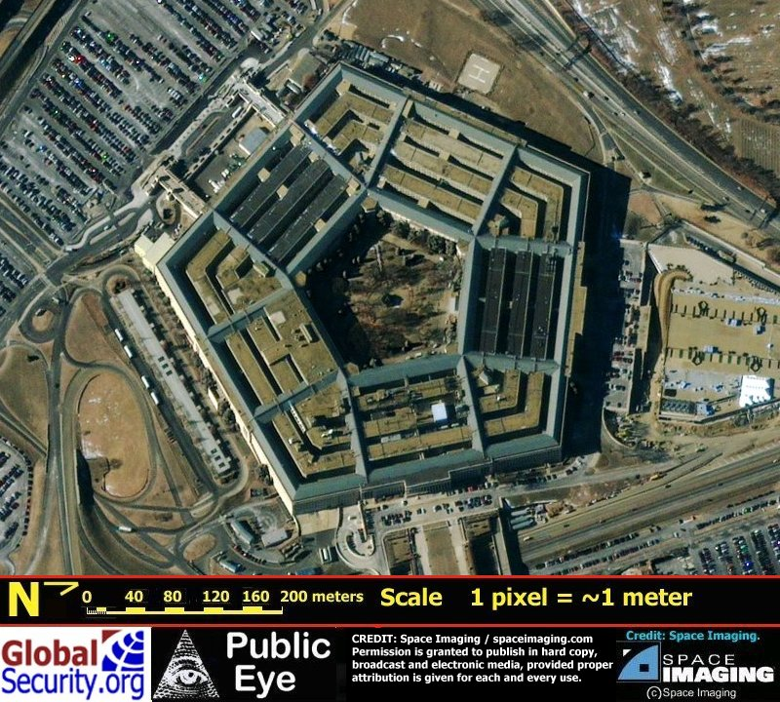
1.6 Classify Polygons
The Pentagon Building is a regular pentagon. If two of the angles are (2x – 14)° and (3x – 75)°. Find the measure of each angle.
44 #4-36 even, 40, 44-54 even
= 24 total
Notes:
2x-14 = 3x-75
-14 = x-75
61 = x
Angles are 2(61) – 14 = 108

Slide 57
1.6 Grading and Quiz
1.6 Answers
1.6 Homework Quiz

Slide 58
1.7 Find Perimeter, Circumference, and Area
Perimeter (P)
Distance around a figure
Circumference (C)
Perimeter of a circle
Area (A)
Amount of surface covered by a figure

Slide 59
1.7 Find Perimeter, Circumference, and Area
Square
Side s
P = 4s
A = s²
Triangle
sides a, b, c
base b, height h
P = a + b + c
A = ½ bh
a
c
s
h
b
Rectangle
Length ℓ
Width w
P = 2ℓ + 2w
A = ℓw
Circle
diameter d
radius r
C = 2πr
A = πr²
r
ℓ
d
w

Slide 60
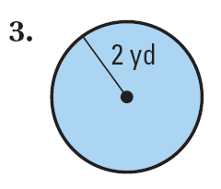
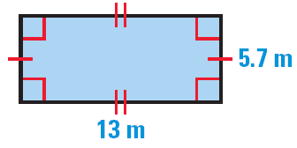
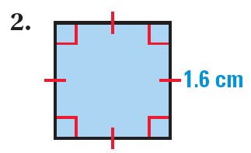
1.7 Find Perimeter, Circumference, and Area
Find the area and perimeter (or circumference) of the figure. If necessary, round to the nearest tenth.
Notes:
Rectangle: A = 13(5.7) = 74.1 m²; P = 2(13) + 2(5.7) = 37.4 m
Square: A = (1.6)² = 2.6 cm²; P = 4(1.6) = 6.4 cm
Circle: A = π(2)² = 4π = 12.6 yd²; P = 2π2 = 4π = 12.6 yd

Slide 61
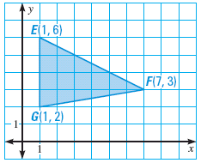
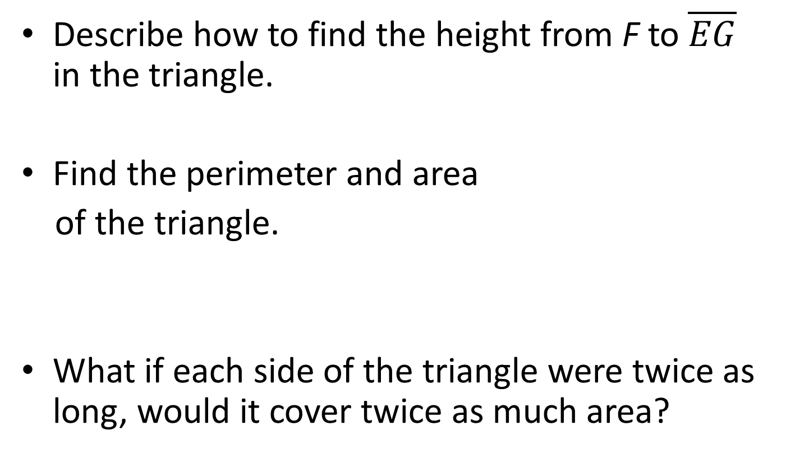
1.7 Find Perimeter, Circumference, and Area
Describe how to find the height from F to $\overline{EG}$ in the triangle.
Find the perimeter and area
of the triangle.
What if each side of the triangle were twice as long, would it cover twice as much area?
Notes:
The height is perpendicular to the base, so it hits EG at (1, 3). Distance from (1, 3) to (7, 3) = 6
Perimeter: find the lengths of each side
EG = 4
FG = √((7-1)² + (3-2)²) = √(36 + 1) = √37 = 6.08
EF = √((7-1)² + (3-6)²) = √(36 + 9) = √45 = 6.71
P = 4 + 6.08 + 6.71 = 16.79
Area: ½ (4)(6) = 12
No, the area would be four times as big

Slide 62
1.7 Find Perimeter, Circumference, and Area
The area of a triangle is 64 square meters, and its height is 16 meters. Find the length of its base.
52 #2-42 even, 46, 48-52 all = 27 total
Extra Credit 56 #2, 6
Notes:
A = ½ bh
64 = ½ b (16)
64 = 8b
b = 8

Slide 63
1.7 Grading and Quiz
1.7 Answers
1.7 Homework Quiz

Slide 64
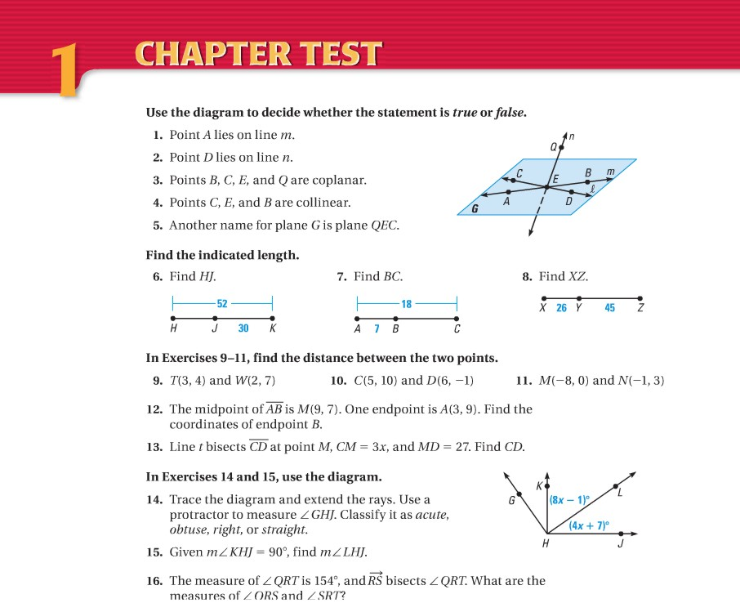
1.Review
64 #1-22 = 22 total

